Slide 1
Investigating the Robustness of Transfer Entropy Through Synthetic Data
Research Question:
When ranking nodes in a complex network based on their localizable influence, how sensitive is the outcome to the presence of higher order relationships?
Relevance & Novelty
Transfer Entropy Networks are widely used tools for analyzing complex networks
They have been criticized by James et al.
Criticisms include that Transfer Entropy Networks may ignore the effects of higher order relationships, or falsely localize them
The practical impact of higher order relationships on the utility of Transfer Entropy Networks has not been quantified

Slide 2
Investigating the Robustness of Transfer Entropy Through Synthetic Data
Localizable Influence:
Influence that one node exerts on another
Higher Order Relationships
H(A,B) = higher order relationship
Small H(A,B)
False localization will not change rankings
Ignoring H(A,B) will ignore relatively little information
Large H(A,B)
False localization may change rankings
Ignoring H(A,B) will ignore a more significant amount of information
A
Contributor | Influence
A | 10
B | 8
H(A,B) | 0.5 or 5
C
B
Node Ranking
A
B
Contributor | Influence
A | 10
B | 8.5
Node Ranking
B
A
Contributor | Influence
A | 10
B | 13

Slide 3
Investigating the Robustness of Transfer Entropy Through Synthetic Data
Method:
Multi-Agent System
Use a Watts-Strogatz graph to define the connectivity of agents
The rewiring of step is governed by a parameter called ‘rewiring probability’
The graph is weighted and directed
The direction of an edge determines the direction in which messages are sent
Edge weights quantify probability that child node responds to messages from a parent
Ex: if the edge from Node 0 to Node 2 has a weight of 0.6,
there is a 0.6 probability that Node 2 will send a message if Node 0 sends a message
The maximum edge weight is determined by a parameter called ‘max path weight’
Augment graph with higher order relationships
Each higher order relationship consists of a set of participating nodes and a target node
Relationship output is the geometric mean of the participating nodes’ outgoing messages
Ex: If Node 1 is the target node, and nodes 0 and 2 are the participating nodes
Node 1 <- √(Node 0 * Node 2)
Define an ‘outbox’ for each node to record the number of messages sent at each time step
This will be used to extract time series describing the system behavior later

Slide 4
Investigating the Robustness of Transfer Entropy Through Synthetic Data
Method
Simulation
For a given configuration of the multi-agent system, run the simulation for T time steps
At each time step of the simulation, each agent may perform the following actions:
Send an unsolicited message to its child nodes
Probability determined by parameter called ‘emission probability’
Send messages in response to parent nodes
The maximum messages received is bounded by a parameter called ‘inbox cap’
For each parent node of the agent,
For each message received from that parent node (to a max of ‘inbox cap’),
Send a message with probability equal to the respective edge weight
Send messages in response to higher order relationships
Signal strength equals the geometric mean of messages sent by participating nodes
For each pseudo-message, send a message with p = ‘higher order sensitivity’
Ex: Node 0 sends 8 messages, Node 2 sends 2 messages
Node 1 receives √(8*2) = 4 pseudo-messages
For each pseudo-message, Node 1 messages with p = ‘higher order sensitivity’
If a node sends a message, it is added to that node’s outbox for this timestep
In the following timestep, each of its children will receive all messages that it sent
After the simulation is complete:
Each agent’s message sending history is extracted as a time series
The time series representing each agent’s behavior is binarized

Slide 5
Investigating the Robustness of Transfer Entropy Through Synthetic Data
Method
Transfer Entropy Network
Calculate the transfer entropy between the time series for each pair of nodes
Use these TE values as weights to define the directed edges of a new graph
Ex: If the TE from node 1 to node 0 is 0.5,
add an edge from node 1 to node 0 with weight 0.5
This graph is a TE Network
Node Ranking
Use Katz Centrality to calculate the influence of nodes in a graph
Rank nodes according to this centrality metric
Ranking Comparison
Take the Node Ranking of the TE Network
This ranking shows the localizable influence that the TE network detected
Take the Node Ranking of the graph defining the multi-agent system
This ranking shows the ground truth for localizable influence
Perform rank correlation on the two rankings
This shows us how similar the two rankings are, which tells us how effective TE was

Slide 6
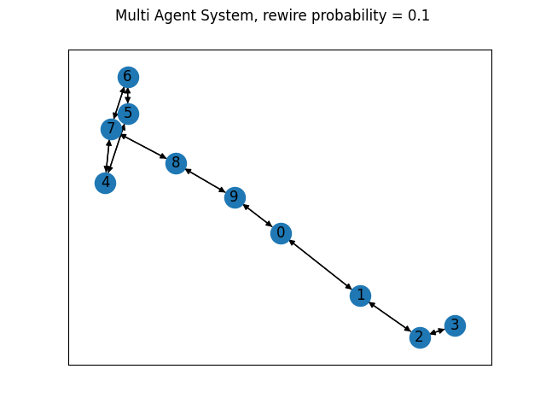
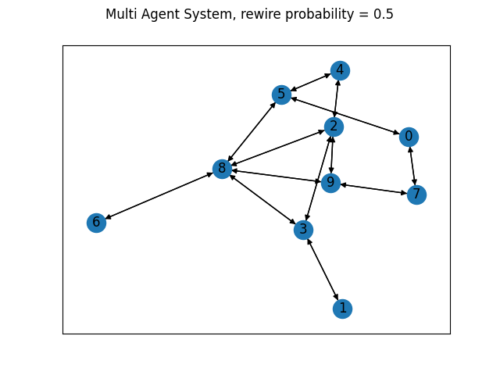
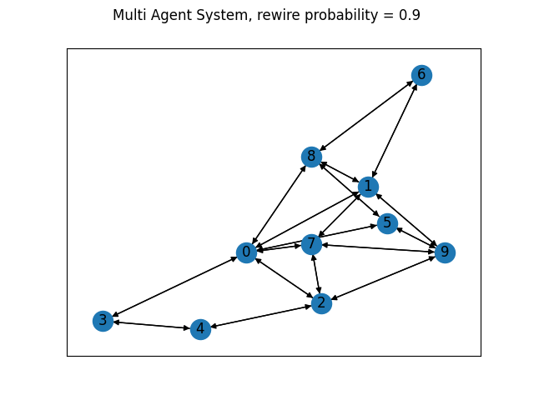
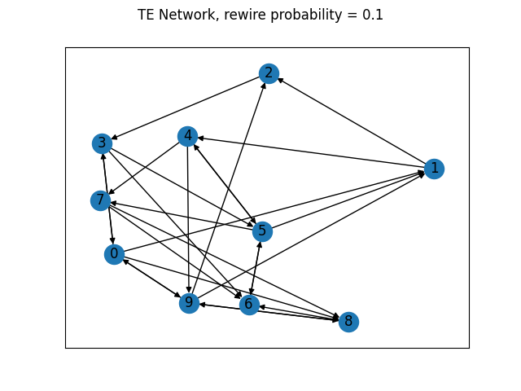
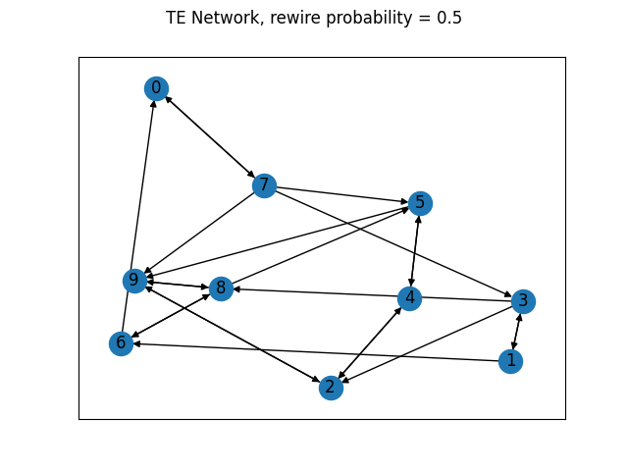
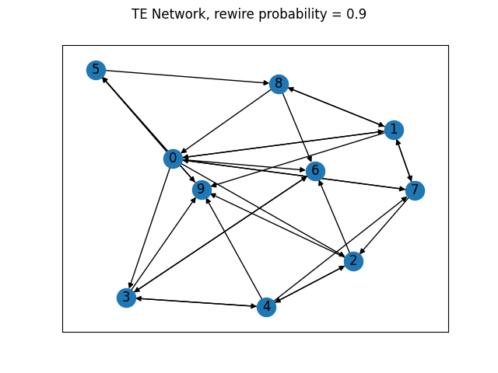
Investigating the Robustness of Transfer Entropy Through Synthetic Data
Sample Multi Agent System Networks and Transfer Entropy Networks

Slide 7
Investigating the Robustness of Transfer Entropy Through Synthetic Data
Test Procedure
Varied five parameters
Rewire Probability: 0.1 to 0.9
Max Path Weight: 0.1 to 0.9
Emission Probability: 0.1 to 0.9
Higher Order Sensitivity: 0.1 to 0.9
Inbox Cap: 1 to 9
Varied configurations of the multi-agent system
Each intersection of:
Number of higher order relationships: 1 to 10
Graph Size: 5 to 50 nodes

Slide 8
Investigating the Robustness of Transfer Entropy Through Synthetic Data
Test Procedure
For each parameter
For each value of that parameter
For each configuration of the multi-agent system:
Obtain 50 Ranking Comparisons with higher order relationships included in the multi-agent system
This is the test sample
Obtain 50 Ranking Comparisons without higher order relationships included in the multi-agent system
This is the control sample
Perform a student's t-test to determine if the two samples share a population mean
H₀: The samples come from the same population
H_{a}: The samples come from two different populations
If higher order relationships impair TE,
We would expect the two samples to come from different populations
P-Value > 0.05 means the samples could not be confidently distinguished
Suggests higher order relationships did not impair TE
P-Value < 0.05 means the samples could be confidently distinguished
Suggests higher order relationships did impair TE

Slide 9
Investigating the Robustness of Transfer Entropy Through Synthetic Data
Results: Rewire Probability
The average P-Values for all graph configurations are very consistent
The average P-Values broken down by graph size or relations are noisier but show a relatively horizontal trend

Slide 10
Investigating the Robustness of Transfer Entropy Through Synthetic Data
Results: Max Path Weight
Average P values show slight positive trend as Max Path Weight increases
The average P-Values broken down by graph size or relations are noisier but show a relatively horizontal trend

Slide 11
Investigating the Robustness of Transfer Entropy Through Synthetic Data
Results: Emission Probability
The average P-Values for all graph configurations have a relatively horizontal trend
The average P-Values broken down by graph size or relations are noisier but show a relatively horizontal trend

Slide 12
Investigating the Robustness of Transfer Entropy Through Synthetic Data
Results: Higher Order Sensitivity
The average P-Values for all graph configurations show a negative trend that grows stronger as higher order sensitivity increases
The average P-Values broken down by relations also show a negative trend that grows stronger as higher order sensitivity increases
The average P-Values broken down by graph size show a scale effect in which smaller graphs are more heavily affected by higher values of higher order sensitivity, but larger graphs are affected relatively evenly

Slide 13
Investigating the Robustness of Transfer Entropy Through Synthetic Data
Results: Inbox Cap
The average P-Values for all graph configurations are very consistent
The average P-Values broken down by graph size or relations are noisier but show a relatively horizontal trend

